Slide 1
Cours de
Gestion de Projets
Approche Prédictive
Mohamed EL AFRIT, PMP®
www.mohamedelafrit.com
mohamed@elafrit.com

Slide 2
Qu'est-ce qu’un Projet?
“Une tentative temporaire entreprise pour créer un produit, un service ou un résultat unique”.
Un projet est:
Temporaire,
Unique,
A une date de début et de fin définie,
Élaboré progressivement.
Fin du projet est atteinte lorsque:
Ses objectifs ont été atteints,
Le projet est arrêté car les objectifs ne sont pas atteints,
Le client / sponsor souhaite annuler le projet,
Le besoin de projet n'existe plus.
Notes:
What is a Project:
“A temporary endeavor undertaken to create a unique product, service, or result”
A project is:
Temporary
Unique
Has a definite start and end date
Progressively elaborated
Has specific time, cost, and performance requirements
Example:
Developing an online portal for selling flowers
Construction of a multistory tower
Setup of new branch of a bank

Slide 3
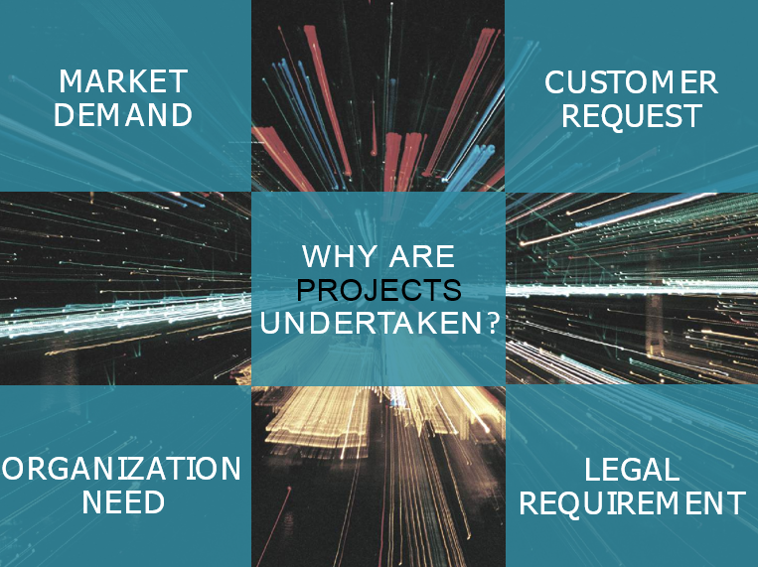

Slide 4
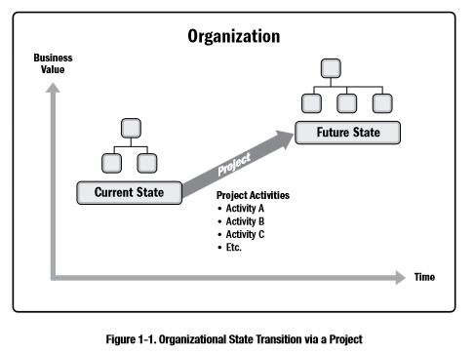

Slide 5
What is “Project management”
The application of a set of knowledge, skills, tools, and techniques to project activities to meet the project objectives.

Slide 6
Qu'est-ce que la Gestion de Projet?
L'application des connaissances, des compétences, des outils et des techniques aux activités du projet pour répondre aux exigences du projet.
La gestion de projet est réalisée au moyen de l'application appropriée et de l'intégration des 49 processus de gestion de projet regroupés de manière logique issus de 10 domaines de connaissance répartis dans 5 groupes de processus.
La Gestion de Projet comprend:
Identifier les exigences.
Répondre aux besoins, aux préoccupations et aux attentes des intervenants.
Mise en place, maintenance et communication entre les intervenants.
Gérer les intervenants pour répondre aux exigences du projet et créer des produits livrables.
Équilibrer les contraintes du projet en compétition.
Notes:
What is Project Management?
The application of knowledge, skills, tools, and techniques to project activities to meet the project requirements.
Accomplished through the appropriate application and integration of the 47 logically grouped project management processes in following 5 process groups:
Initiating
Planning
Executing
Monitoring & Controlling
Closing
Project Management includes
Identifying Requirements
Address needs, concerns and expectations of Stakeholders
Setup, Maintain and carry out Communication among Stakeholders
Manage Stakeholders to meet project requirements and create project deliverables.
Balance the competing project constraints.

Slide 7
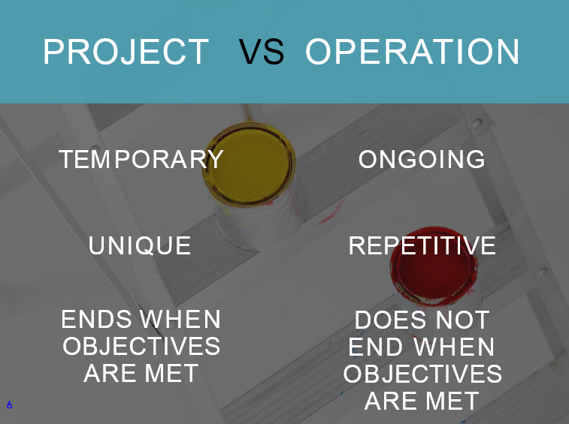

Slide 8
Projet vs Operations
Projet
Le but d'un projet est d'atteindre son objectif puis de se terminer.
Le projet est un catalyseur de changement.
Le projet se termine lorsque ses objectifs spécifiques ont été atteints.
A une date de début et de fin définitives.
Examples:
Développer un nouveau produit ou service.
Déploiement d'un nouveau logiciel.
Operations
L’objectif d’une opération en cours est de soutenir l’activité business.
L'opération maintient le statu quo.
Les opérations adoptent de nouveaux objectifs et le travail se poursuit.
Ne pas avoir une date de fin.
Examples:
Services de soutien à la production.
Traitement des réclamations.
Pay-roll mensuel.
Vérification de nouvelles applications.
Notes:
Project v/s Operation
Project
The purpose of a project is to attain its objective and then terminate
Project is catalyst for change
Project concludes when its specific objectives have been attained
Does have a definitive start and end date
Examples:
Developing a new product or service
Discovery of a new drug
Operations
The objective of an ongoing operation is to sustain the business
Operation is maintaining status quo
Operations adopt a new set of objectives and the work continues
Does not have a end date
Examples:
Production support services
Claims processing
Monthly Pay-roll
Verification of new applications

Slide 9
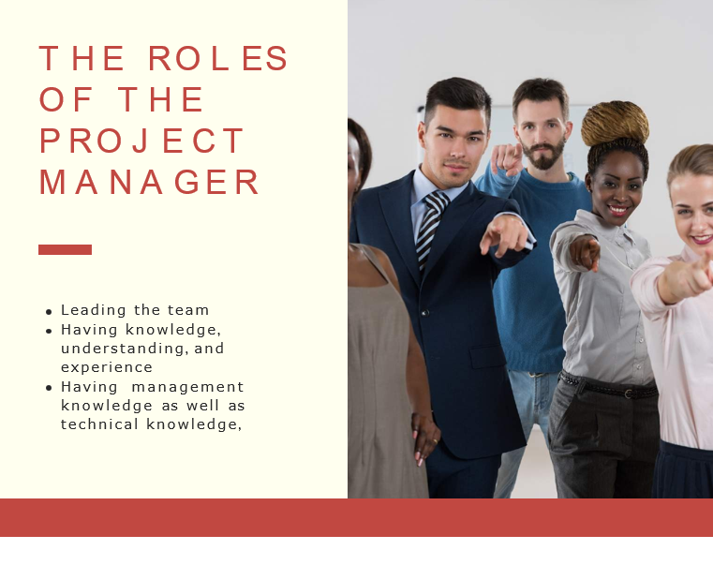

Slide 10
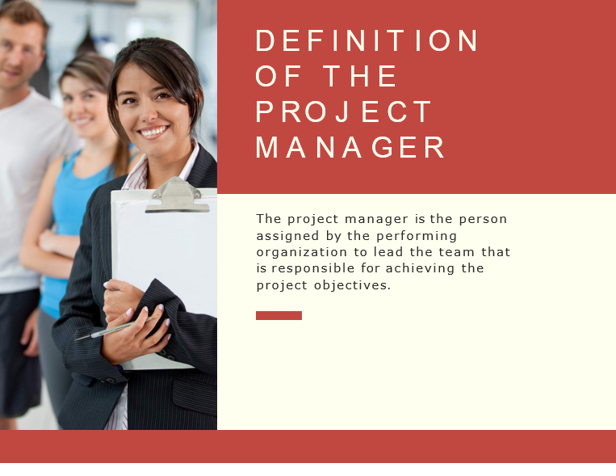

Slide 11
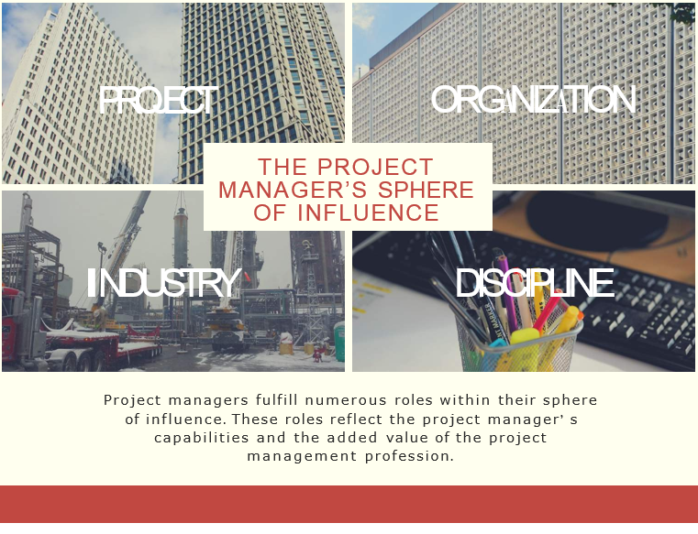

Slide 12
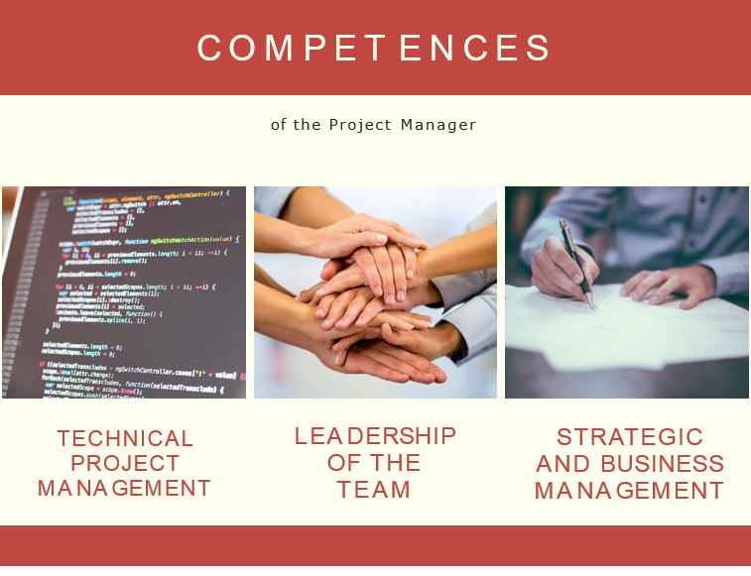

Slide 13


Slide 14
Cycle de vie du projet v/s Cycle de vie du produit
Le cycle de vie d'un projet est la série de phases franchies par un projet, de son lancement à sa clôture.
Les phases peuvent être ventilées par objectifs fonctionnels ou partiels, résultats intermédiaires ou livrables, jalons spécifiques dans l’ensemble du travail ou disponibilité financière.
Un cycle de vie de produit est un ensemble de phases de produit généralement séquentielles, ne se chevauchant pas, dont le nom et le nombre sont déterminés par les besoins de fabrication et de contrôle de l'organisation.
La dernière phase du cycle de vie d’un produit correspond généralement à son retrait. Généralement, un cycle de vie de projet est contenu dans un ou plusieurs cycles de vie de produit.
Notes:
Project Life Cycle
What is a Project life cycle?
A project life cycle is the series of phases that a project passes through from its initiation to its closure.
The phases can be broken down by functional or partial objectives, intermediate results or deliverables, specific milestones within the overall scope of work, or financial availability.
A life cycle can be documented within a methodology.
The life cycle provides the basic framework for managing the project, regardless of the specific work involved.
Characteristics of Project Life cycle include:
Starting the Project
Organizing and preparing
Carrying out the project work
Closing the project.

Slide 15
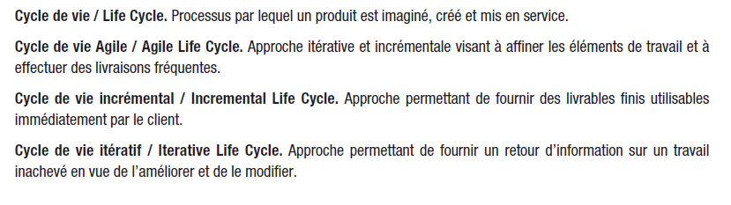
Source : PMBOK
Notes:
Project Life Cycle
What is a Project life cycle?
A project life cycle is the series of phases that a project passes through from its initiation to its closure.
The phases can be broken down by functional or partial objectives, intermediate results or deliverables, specific milestones within the overall scope of work, or financial availability.
A life cycle can be documented within a methodology.
The life cycle provides the basic framework for managing the project, regardless of the specific work involved.
Characteristics of Project Life cycle include:
Starting the Project
Organizing and preparing
Carrying out the project work
Closing the project.

Slide 16
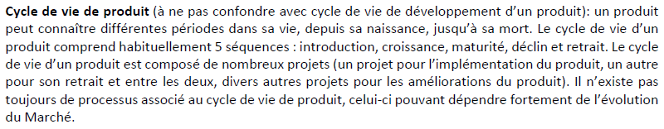
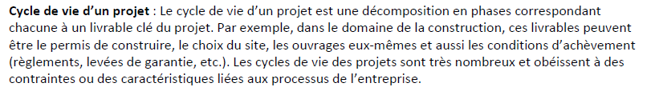
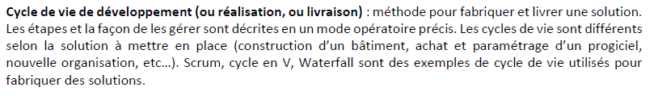
Cycle de vie du produit
Cycle de vie du projet
Cycle de vie de développement
Source : PMI
Notes:
Project Life Cycle
What is a Project life cycle?
A project life cycle is the series of phases that a project passes through from its initiation to its closure.
The phases can be broken down by functional or partial objectives, intermediate results or deliverables, specific milestones within the overall scope of work, or financial availability.
A life cycle can be documented within a methodology.
The life cycle provides the basic framework for managing the project, regardless of the specific work involved.
Characteristics of Project Life cycle include:
Starting the Project
Organizing and preparing
Carrying out the project work
Closing the project.

Slide 17
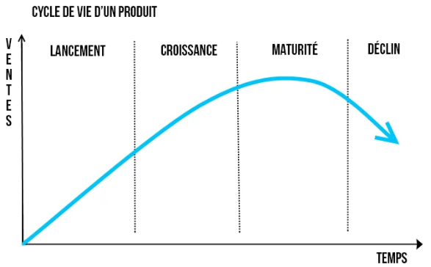
Product Management vs Project Management

Slide 18
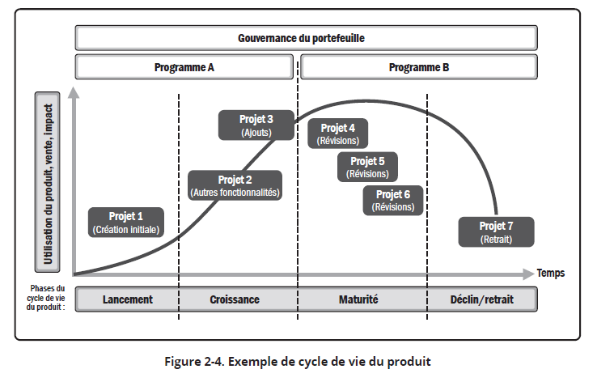
Source : PMBOK 7 - Standard – P19
Notes:
Project Life Cycle
What is a Project life cycle?
A project life cycle is the series of phases that a project passes through from its initiation to its closure.
The phases can be broken down by functional or partial objectives, intermediate results or deliverables, specific milestones within the overall scope of work, or financial availability.
A life cycle can be documented within a methodology.
The life cycle provides the basic framework for managing the project, regardless of the specific work involved.
Characteristics of Project Life cycle include:
Starting the Project
Organizing and preparing
Carrying out the project work
Closing the project.

Slide 19
Product Management
PRODUCT LIFE CYCLE
Aims to maintain the product throughout the product life cycle
SALES
INTRODUCTION
GROWTH
MATURITY
DECLINE
TIME

Slide 20
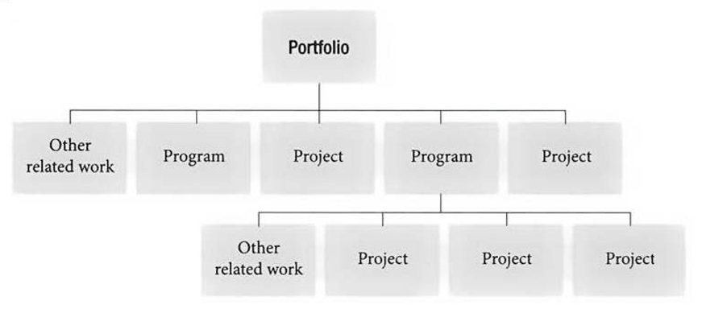
Project vs Program vs Portfolio

Slide 21
Example
Digitalize the organization (Vision)
Portfolio
Acquiring an ERP
Project
Elaborate the RFP
Setting up the IT infrastructure
Implementing the ERP
Portfolio
Program
Project
Purchase module
Finance module
HR module

Slide 22
Project Life Cycle vs Product life cycle
Opportunity
identified
Product
launch
New idea
Outcome
agreed
Product lifecycle
Product
Project
Project start
Project finish

Slide 23
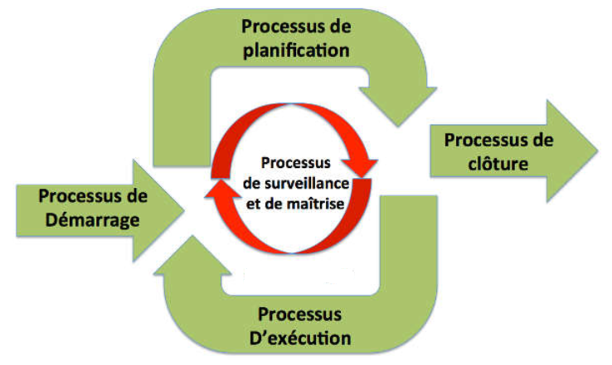
Cycle de vie du projet

Slide 24
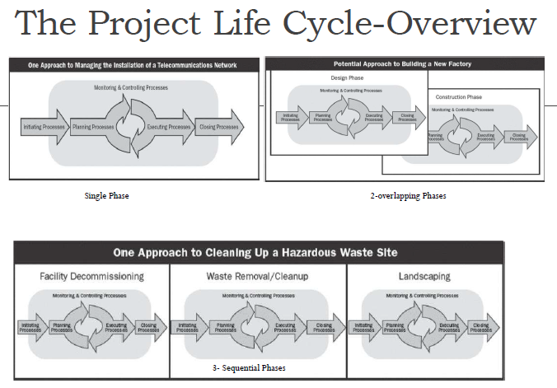
Source : PMBOK
Notes:
Project Life Cycle
What is a Project life cycle?
A project life cycle is the series of phases that a project passes through from its initiation to its closure.
The phases can be broken down by functional or partial objectives, intermediate results or deliverables, specific milestones within the overall scope of work, or financial availability.
A life cycle can be documented within a methodology.
The life cycle provides the basic framework for managing the project, regardless of the specific work involved.
Characteristics of Project Life cycle include:
Starting the Project
Organizing and preparing
Carrying out the project work
Closing the project.

Slide 25
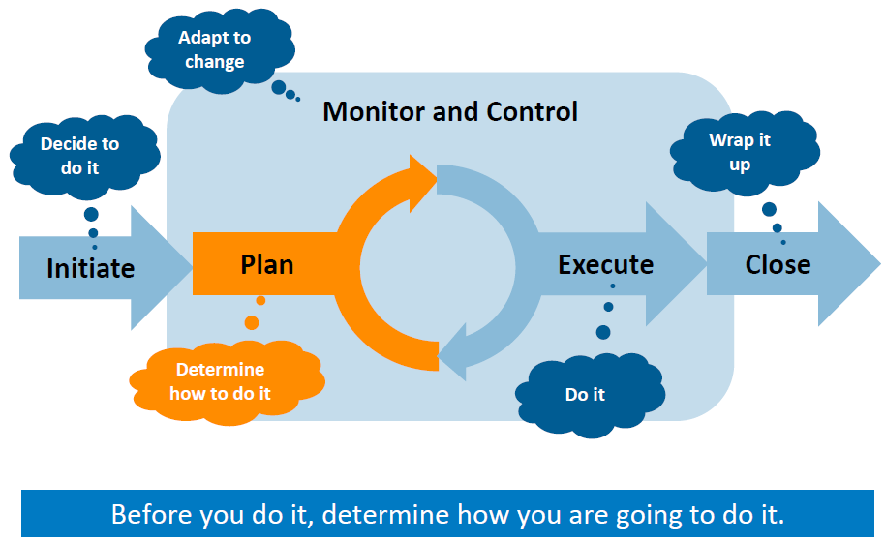
Notes:
Project Life Cycle
What is a Project life cycle?
A project life cycle is the series of phases that a project passes through from its initiation to its closure.
The phases can be broken down by functional or partial objectives, intermediate results or deliverables, specific milestones within the overall scope of work, or financial availability.
A life cycle can be documented within a methodology.
The life cycle provides the basic framework for managing the project, regardless of the specific work involved.
Characteristics of Project Life cycle include:
Starting the Project
Organizing and preparing
Carrying out the project work
Closing the project.

Slide 26
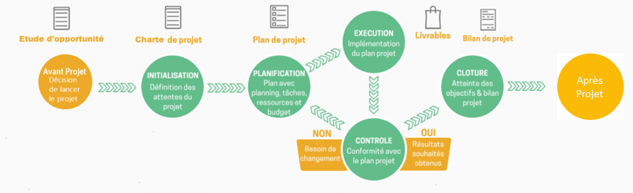
Source : blog-gestion-de-projet.com
Notes:
Project Life Cycle
What is a Project life cycle?
A project life cycle is the series of phases that a project passes through from its initiation to its closure.
The phases can be broken down by functional or partial objectives, intermediate results or deliverables, specific milestones within the overall scope of work, or financial availability.
A life cycle can be documented within a methodology.
The life cycle provides the basic framework for managing the project, regardless of the specific work involved.
Characteristics of Project Life cycle include:
Starting the Project
Organizing and preparing
Carrying out the project work
Closing the project.

Slide 27
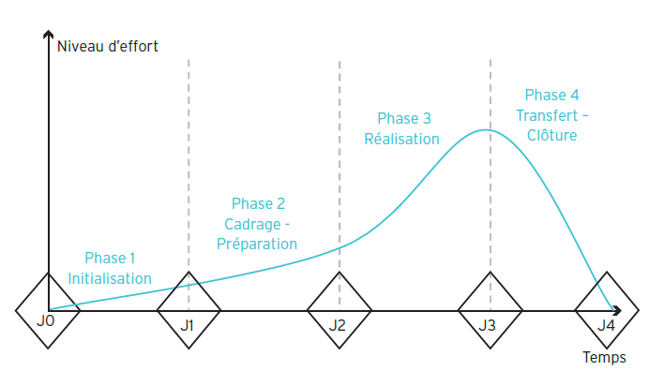

Slide 28
Source : PMBOK
Notes:
Project Life Cycle
What is a Project life cycle?
A project life cycle is the series of phases that a project passes through from its initiation to its closure.
The phases can be broken down by functional or partial objectives, intermediate results or deliverables, specific milestones within the overall scope of work, or financial availability.
A life cycle can be documented within a methodology.
The life cycle provides the basic framework for managing the project, regardless of the specific work involved.
Characteristics of Project Life cycle include:
Starting the Project
Organizing and preparing
Carrying out the project work
Closing the project.

Slide 29
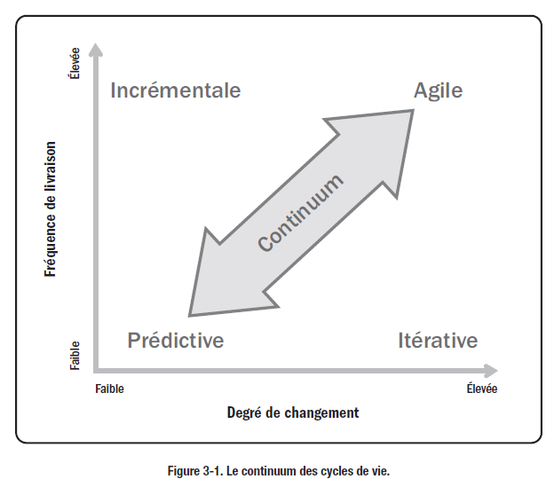
Source : PMBOK
Notes:
Project Life Cycle
What is a Project life cycle?
A project life cycle is the series of phases that a project passes through from its initiation to its closure.
The phases can be broken down by functional or partial objectives, intermediate results or deliverables, specific milestones within the overall scope of work, or financial availability.
A life cycle can be documented within a methodology.
The life cycle provides the basic framework for managing the project, regardless of the specific work involved.
Characteristics of Project Life cycle include:
Starting the Project
Organizing and preparing
Carrying out the project work
Closing the project.

Slide 30
Source : PMBOK
Notes:
Project Life Cycle
What is a Project life cycle?
A project life cycle is the series of phases that a project passes through from its initiation to its closure.
The phases can be broken down by functional or partial objectives, intermediate results or deliverables, specific milestones within the overall scope of work, or financial availability.
A life cycle can be documented within a methodology.
The life cycle provides the basic framework for managing the project, regardless of the specific work involved.
Characteristics of Project Life cycle include:
Starting the Project
Organizing and preparing
Carrying out the project work
Closing the project.

Slide 31
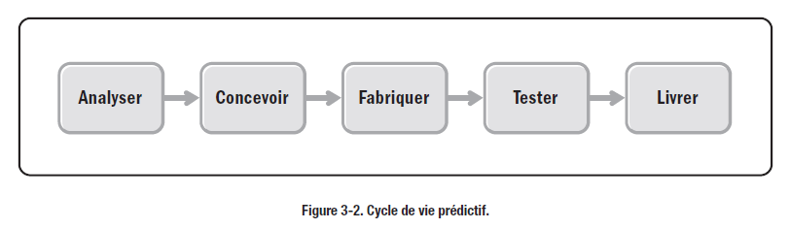
Cycle de vie de développement
Source : PMBOK
Notes:
Project Life Cycle
What is a Project life cycle?
A project life cycle is the series of phases that a project passes through from its initiation to its closure.
The phases can be broken down by functional or partial objectives, intermediate results or deliverables, specific milestones within the overall scope of work, or financial availability.
A life cycle can be documented within a methodology.
The life cycle provides the basic framework for managing the project, regardless of the specific work involved.
Characteristics of Project Life cycle include:
Starting the Project
Organizing and preparing
Carrying out the project work
Closing the project.

Slide 32
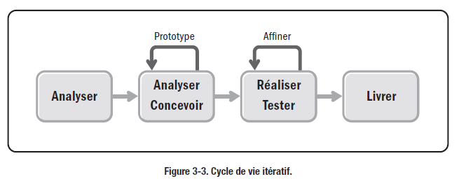
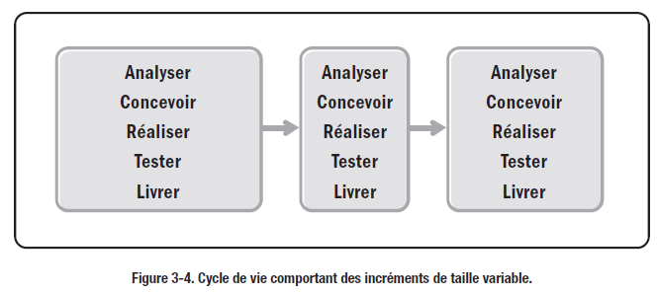
Source : PMBOK
Notes:
Project Life Cycle
What is a Project life cycle?
A project life cycle is the series of phases that a project passes through from its initiation to its closure.
The phases can be broken down by functional or partial objectives, intermediate results or deliverables, specific milestones within the overall scope of work, or financial availability.
A life cycle can be documented within a methodology.
The life cycle provides the basic framework for managing the project, regardless of the specific work involved.
Characteristics of Project Life cycle include:
Starting the Project
Organizing and preparing
Carrying out the project work
Closing the project.

Slide 33
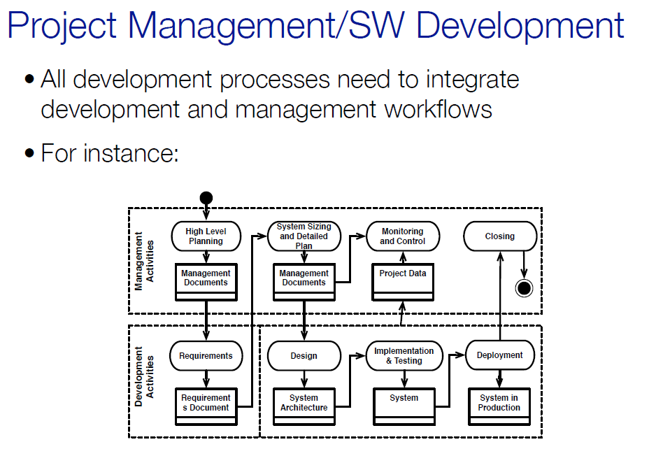
La gestion de projet informatique
Cycle de vie du projet
Cycle de vie de développement
Notes:
What is Project Management?
The application of knowledge, skills, tools, and techniques to project activities to meet the project requirements.
Accomplished through the appropriate application and integration of the 47 logically grouped project management processes in following 5 process groups:
Initiating
Planning
Executing
Monitoring & Controlling
Closing
Project Management includes
Identifying Requirements
Address needs, concerns and expectations of Stakeholders
Setup, Maintain and carry out Communication among Stakeholders
Manage Stakeholders to meet project requirements and create project deliverables.
Balance the competing project constraints.

Slide 34
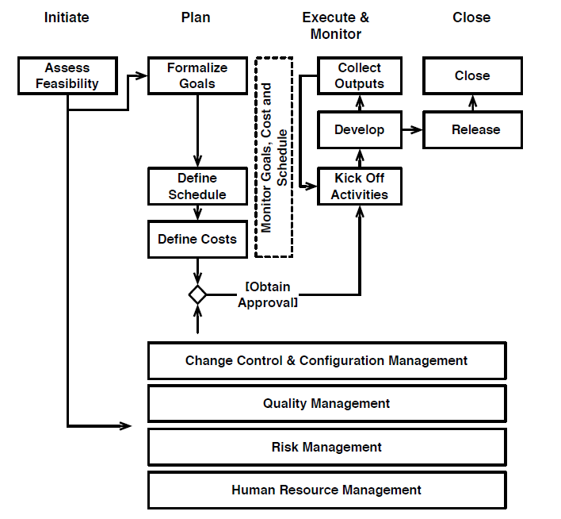
Source : www.spmbook.com
Notes:
Project Life Cycle
What is a Project life cycle?
A project life cycle is the series of phases that a project passes through from its initiation to its closure.
The phases can be broken down by functional or partial objectives, intermediate results or deliverables, specific milestones within the overall scope of work, or financial availability.
A life cycle can be documented within a methodology.
The life cycle provides the basic framework for managing the project, regardless of the specific work involved.
Characteristics of Project Life cycle include:
Starting the Project
Organizing and preparing
Carrying out the project work
Closing the project.

Slide 35

Tailoring
Selection of appropriate processes, tools, inputs, techniques & lifecycle phases
Tailoring considers projects constraints, governance, culture, customer
Lead by the project manager in a collaborative manner
When you don’t tailor your processes

Slide 36
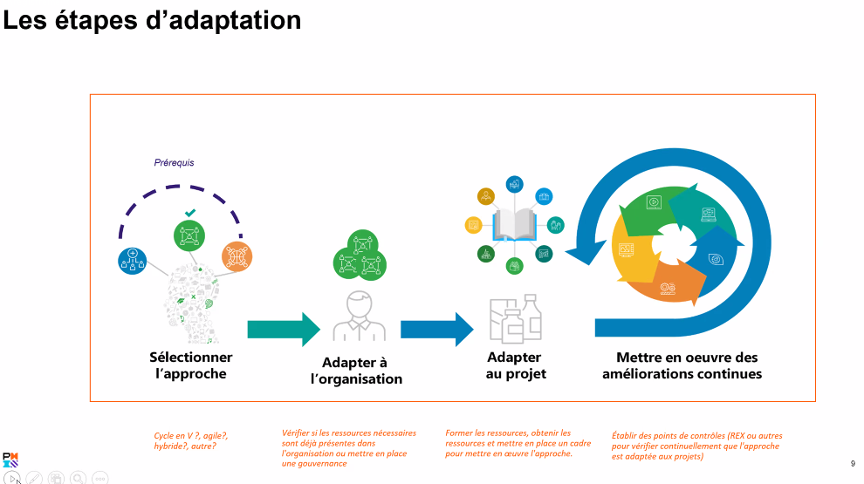
Source : PMI-France Groupe étude PMBOK 7
Notes:
Project Life Cycle
What is a Project life cycle?
A project life cycle is the series of phases that a project passes through from its initiation to its closure.
The phases can be broken down by functional or partial objectives, intermediate results or deliverables, specific milestones within the overall scope of work, or financial availability.
A life cycle can be documented within a methodology.
The life cycle provides the basic framework for managing the project, regardless of the specific work involved.
Characteristics of Project Life cycle include:
Starting the Project
Organizing and preparing
Carrying out the project work
Closing the project.

Slide 37
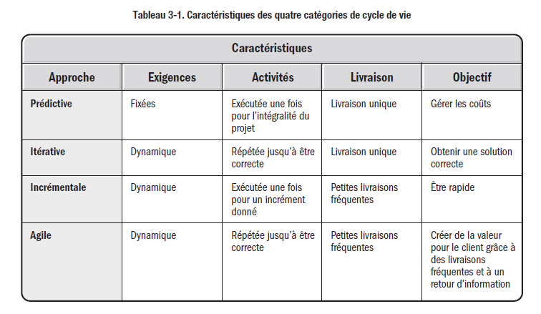
Source : PMI Guide Pratique Agile - Page 18
Notes:
Project Life Cycle
What is a Project life cycle?
A project life cycle is the series of phases that a project passes through from its initiation to its closure.
The phases can be broken down by functional or partial objectives, intermediate results or deliverables, specific milestones within the overall scope of work, or financial availability.
A life cycle can be documented within a methodology.
The life cycle provides the basic framework for managing the project, regardless of the specific work involved.
Characteristics of Project Life cycle include:
Starting the Project
Organizing and preparing
Carrying out the project work
Closing the project.

Slide 38
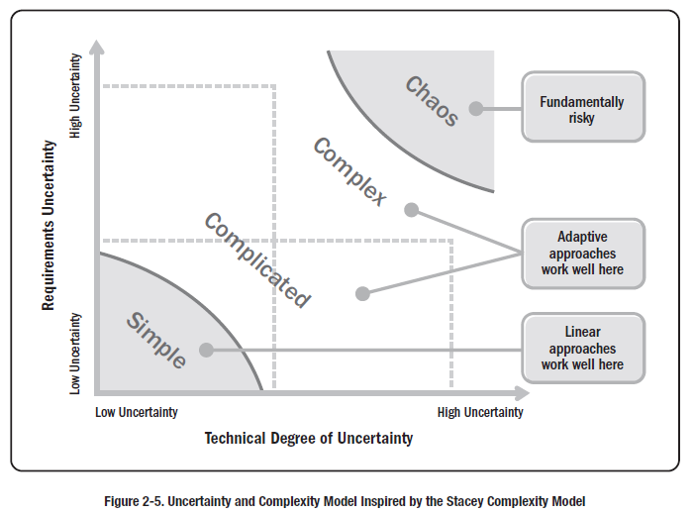
Agile Practice Guide – Page 29

Slide 39
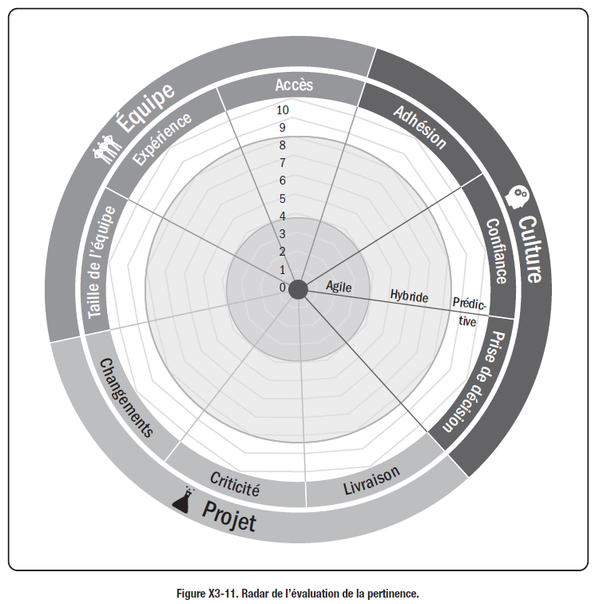
Source :
PMI Guide Pratique Agile - Page 127
Notes:
Project Life Cycle
What is a Project life cycle?
A project life cycle is the series of phases that a project passes through from its initiation to its closure.
The phases can be broken down by functional or partial objectives, intermediate results or deliverables, specific milestones within the overall scope of work, or financial availability.
A life cycle can be documented within a methodology.
The life cycle provides the basic framework for managing the project, regardless of the specific work involved.
Characteristics of Project Life cycle include:
Starting the Project
Organizing and preparing
Carrying out the project work
Closing the project.

Slide 40
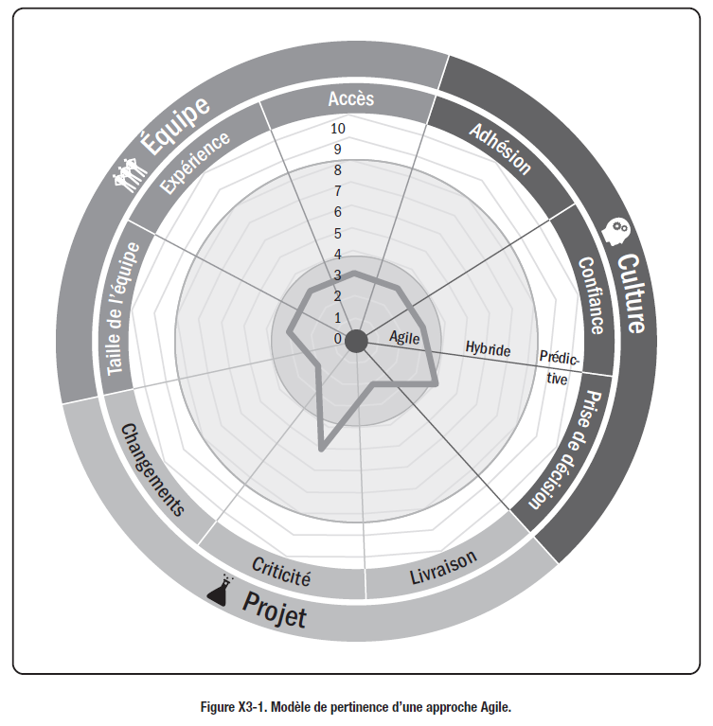
Source :
PMI Guide Pratique Agile
Notes:
Project Life Cycle
What is a Project life cycle?
A project life cycle is the series of phases that a project passes through from its initiation to its closure.
The phases can be broken down by functional or partial objectives, intermediate results or deliverables, specific milestones within the overall scope of work, or financial availability.
A life cycle can be documented within a methodology.
The life cycle provides the basic framework for managing the project, regardless of the specific work involved.
Characteristics of Project Life cycle include:
Starting the Project
Organizing and preparing
Carrying out the project work
Closing the project.

Slide 41
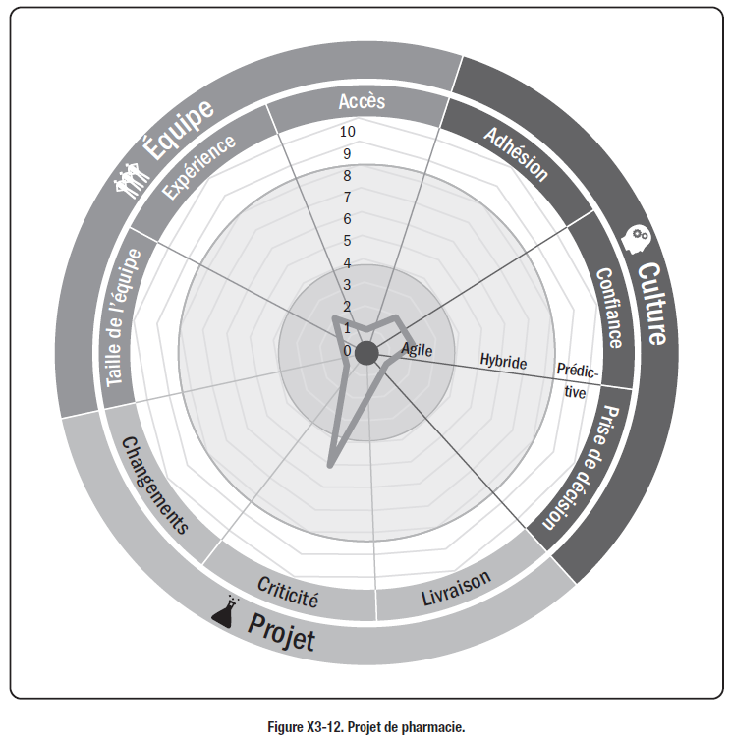
Source :
PMI Guide Pratique Agile
Notes:
Project Life Cycle
What is a Project life cycle?
A project life cycle is the series of phases that a project passes through from its initiation to its closure.
The phases can be broken down by functional or partial objectives, intermediate results or deliverables, specific milestones within the overall scope of work, or financial availability.
A life cycle can be documented within a methodology.
The life cycle provides the basic framework for managing the project, regardless of the specific work involved.
Characteristics of Project Life cycle include:
Starting the Project
Organizing and preparing
Carrying out the project work
Closing the project.

Slide 42
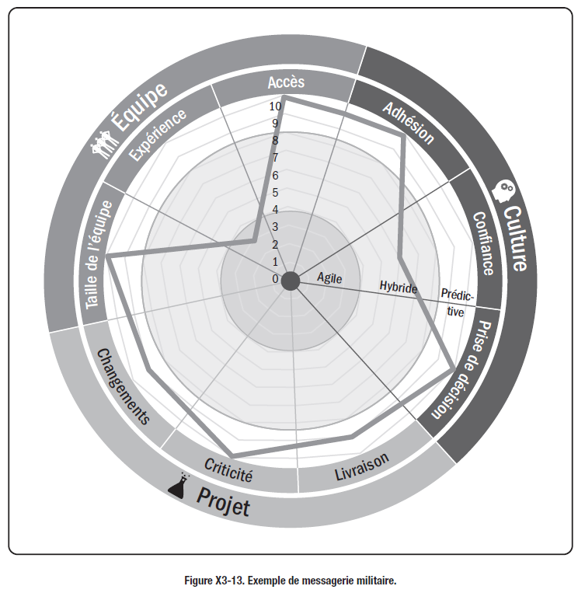
Source :
PMI Guide Pratique Agile
Notes:
Project Life Cycle
What is a Project life cycle?
A project life cycle is the series of phases that a project passes through from its initiation to its closure.
The phases can be broken down by functional or partial objectives, intermediate results or deliverables, specific milestones within the overall scope of work, or financial availability.
A life cycle can be documented within a methodology.
The life cycle provides the basic framework for managing the project, regardless of the specific work involved.
Characteristics of Project Life cycle include:
Starting the Project
Organizing and preparing
Carrying out the project work
Closing the project.

Slide 43
Culture de l’organisation
La culture et le style de l'organisation influent sur la manière dont elle conduit les projets. La culture organisationnelle est façonnée par l'expérience commune des membres de l'organisation.
Vision, mission et valeur partagées.
Politiques, processus, procédures, méthodes, etc.
Système de motivation et de récompense.
Tolérance au risque.
Point de vue sur le leadership, la hiérarchie et la relation d'autorité.
Code de conduite, éthique de travail et heures de travail.
Environnements d'exploitation.
Notes:
Organization Culture
Organizations are systematic arrangements of entities (persons and/or departments) aimed at accomplishing
a purpose, which may involve undertaking projects. An organization’s culture and style affect how it conducts projects.
Cultures and styles are group phenomena known as cultural norms, which develop over time. The norms include
established approaches to initiating and planning projects, the means considered acceptable for getting the work
done, and recognized authorities who make or influence decisions.
Organizational culture is shaped by the common experiences of members of the organization and most organizations
have developed unique cultures over time by practice and common usage. Common experiences include, but are not
limited to:
Shared vision, mission and value
Policies, Process, Procedure, Methods etc.
Motivation & reward system
Risk tolerance
View of leadership, hierarchy, and authority relationship
Code of conduct, work ethics, and work hours
Operating environments

Slide 44
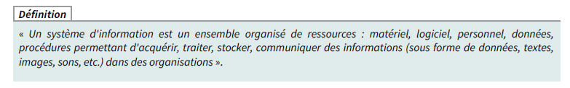
Définition du système d’information
Le SI sert à quoi ?
Le SI sert de support aux processus métiers réalisés par les acteurs dans un cadre organisationnel.

Slide 45
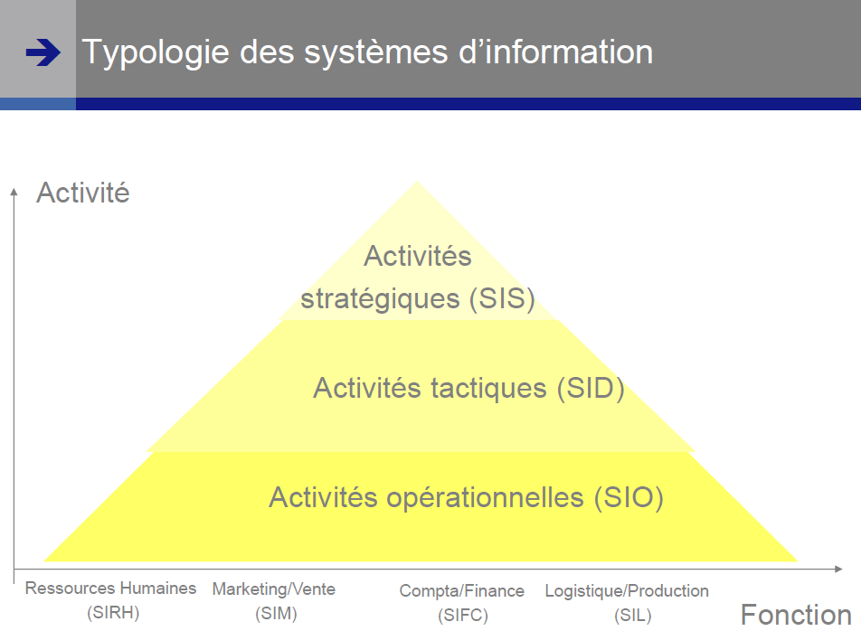

Slide 46
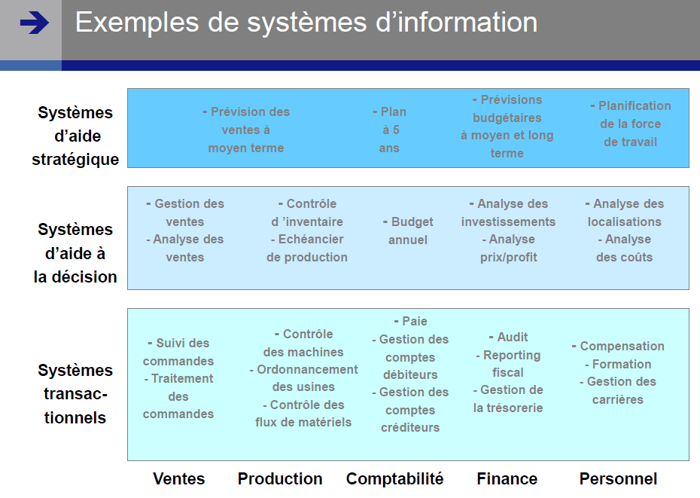

Slide 47
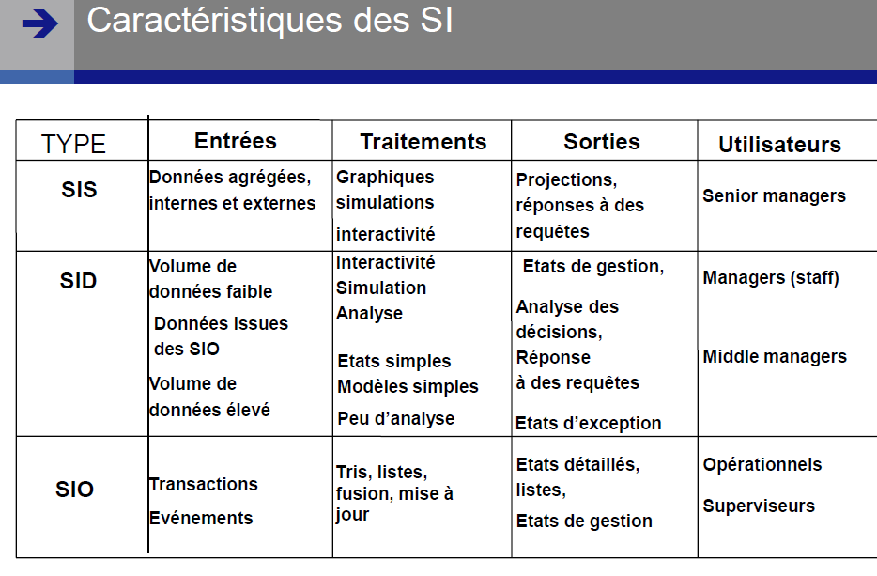

Slide 48
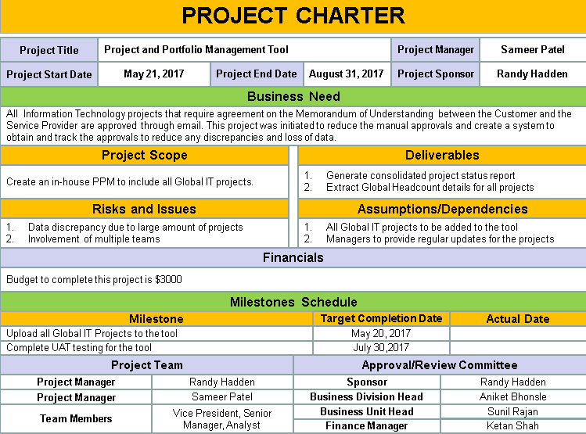
Project charter

Slide 50
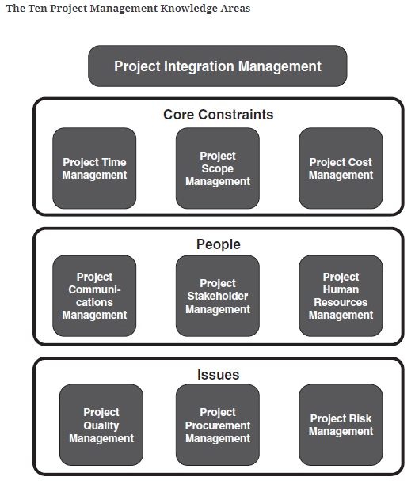
Source : « Successful Project Management » by Michael S. Dobson

Slide 51
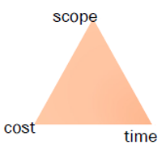
Les contraintes principales d’un projet (Core Project Constraints)
Quality
(Resources)

Slide 52
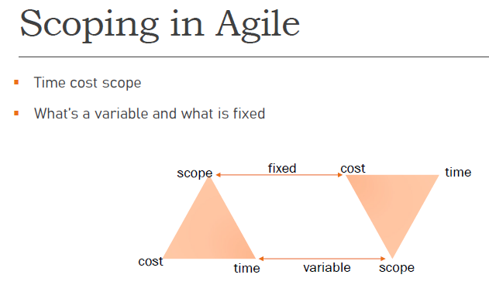

Slide 53
Les parties prenantes du Projet (Project Stakeholders)
Un stakeholder est un individu, un groupe ou une organisation qui peut être affecté par la décision, l'activité ou les résultats d'un projet.
Example : Client, fournisseur, agences, employé, etc.
Stakeholder positif:
Supporter du projet,
Exemple - Sponsor.
Stakeholder négatif:
Resister au projet,
Exemple - Une personne qui a perdu son emploi.
Stakeholder neutre:
Ni partisan ni résistant,
Exemple - Travail journalier sur le projet.
Notes:
Project Stakeholder
A stakeholder is an individual, group or organization who may be affected by the decision, activity, or outcome of a project.
Example : Customer, Supplier, Agencies, Employee etc.
Positive Stakeholder
Supporter of project
Example - Sponsor
Negative Stakeholder
Resister of project
Example – Person loosing job
Neutral Stakeholder
Neither supporter nor resister
Example – Daily wage labour on the project

Slide 54
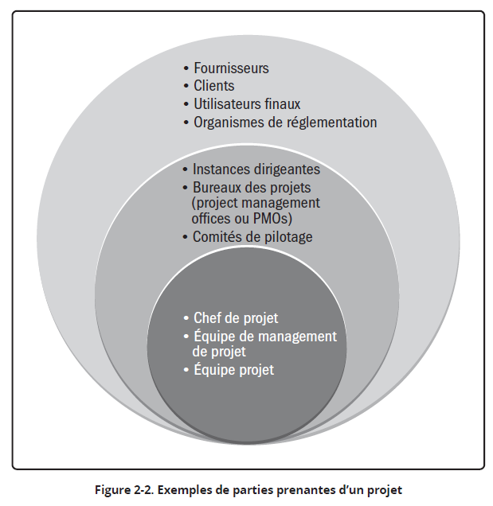
Source : PMBOK 7 Guide – P9

Slide 55
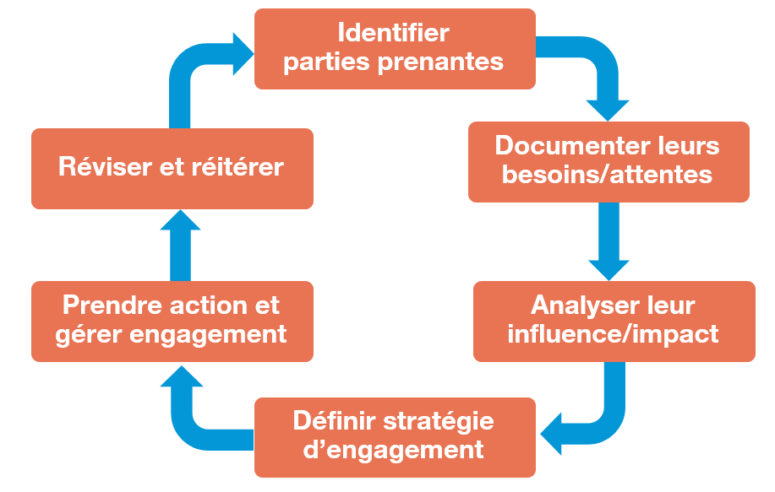

Slide 56
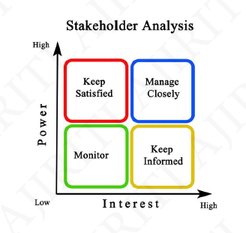
Comment gérer une partie prenante?

Slide 57
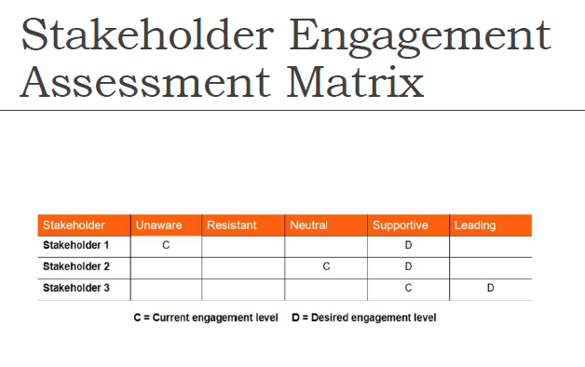
Comment gérer une partie prenante?
Matrice d’évaluation des parties prenantes

Slide 58
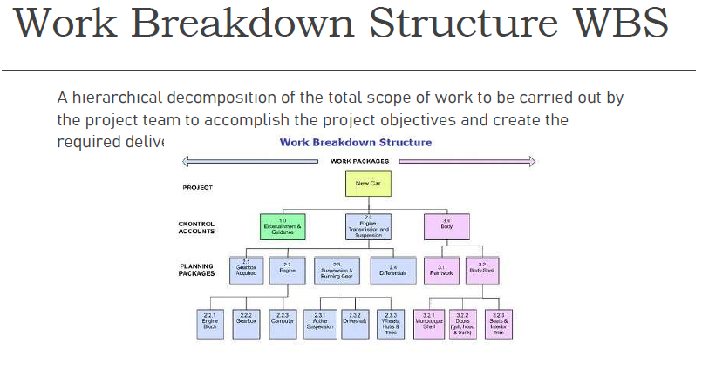

Slide 59
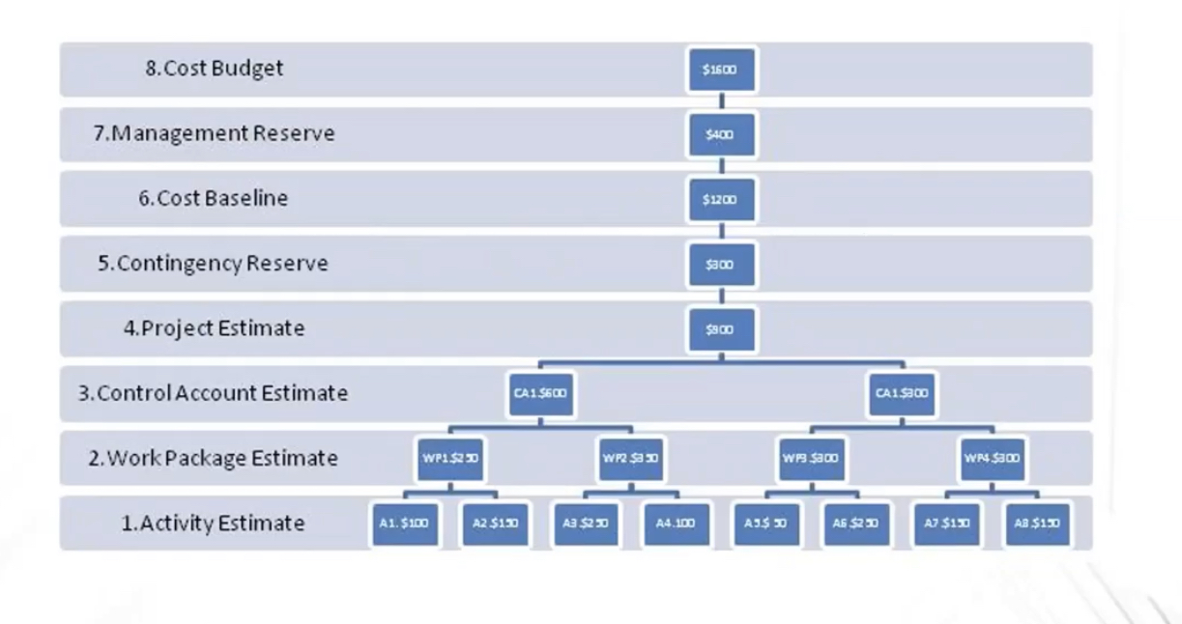

Slide 60
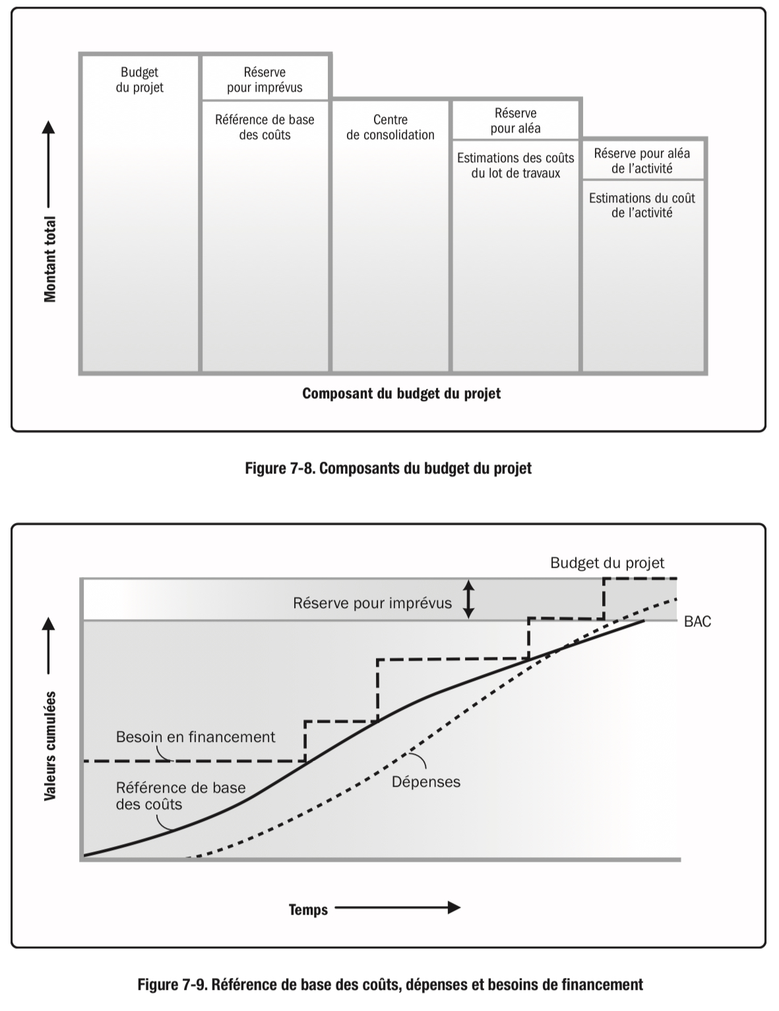

Slide 62
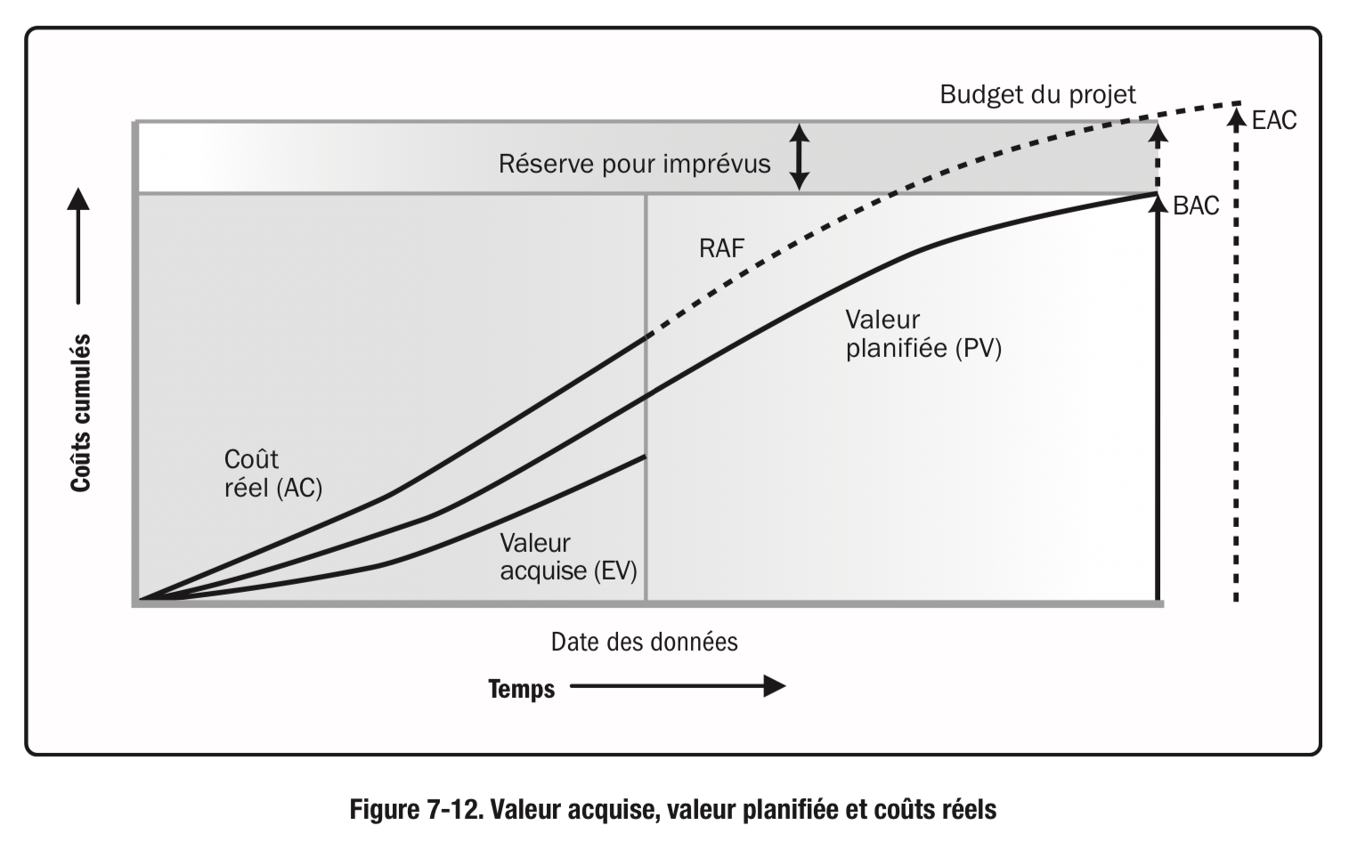

Slide 63
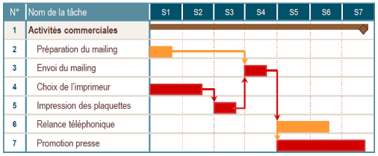

Slide 64
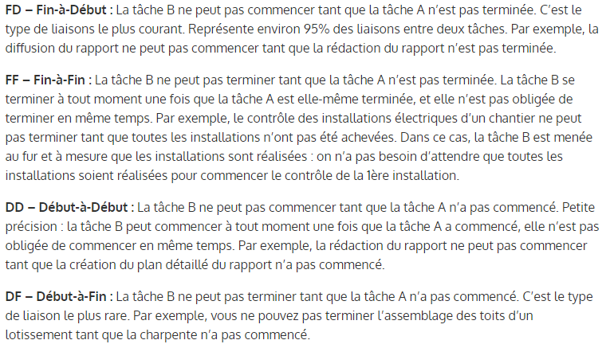

Slide 65


Slide 66


Slide 67


Slide 68


Slide 69


Slide 70



Slide 71



Slide 72


Slide 73

Matrice RACI

Slide 74

Fixer des Objectifs SMART

Slide 75
Les limites du Waterfall Project Management
Planification sur le long terme sans prendre en compte les changements et les modifications faites
Cette méthode ne prend pas en compte l’évolution du périmètre de projet au cœur de leur exécution
Elle alloue des ressources sans connaître au préalable leur disponibilités et leurs capacités
N’est pas forcément adaptées aux réalités actuelles car elle est devenu trop complexe et donc, moins efficace (en fonction du domaine métier)
Reste statique face à un environnement de travail qui évolue

Slide 76


Slide 78


Slide 79


Slide 80


Slide 81


Slide 82


Slide 83


Slide 84


Slide 85


Slide 86


Slide 87


Slide 88


Slide 89


Slide 90
Sources et bibliographie :
PMBOK 6 & PMBOK 7 https://www.pmi.org
PM kickoff : https://kickoff.pmi.org
Introduction to Software Project Management, Adolfo Villafiorita : https://www.spmbook.com
MOOC Gestion De Projet :
https://gestiondeprojet.pm/les-ressources
http://rb.ec-lille.fr/gestion_projet.htm
Process Flow by Ricardo Vargas : https://ricardo-vargas.com/pmbok6-processes-flow
Project Lab : http://wiki.doing-projects.org/index.php/Main_Page
MIT OCW : System Project Management : https://ocw.mit.edu/courses/esd-36-system-project-management-fall-2012/pages/lecture-notes/
European Commission Project Management Methodology (PM²) https://joinup.ec.europa.eu/collection/pm2-project-management-methodology/news/french-pm2-artefacts-now-available
University of Waterloo Project Management Tools and Templates : https://uwaterloo.ca/ist-project-management-office/
Blog Gestion de Projet : https://blog-gestion-de-projet.com/

